Slide 1

Health Disease
Prediction
JA2: Stonkers

Slide 2
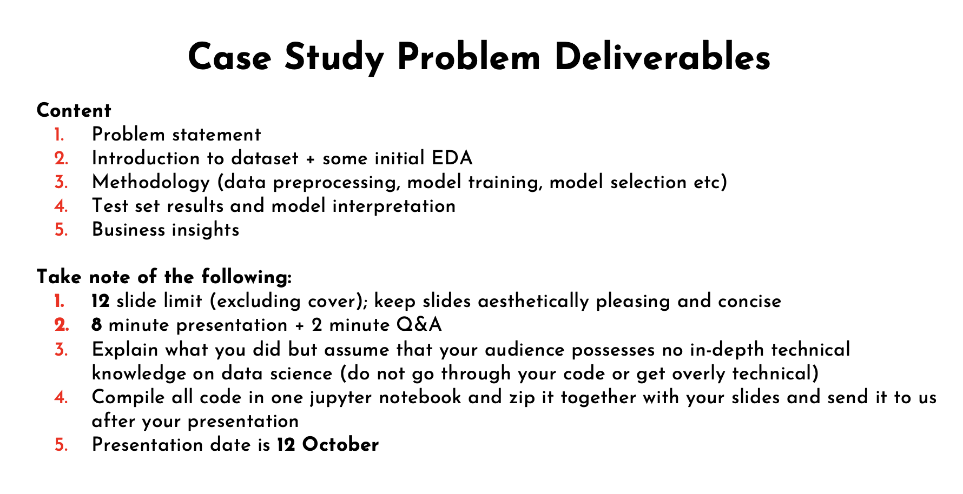

Slide 3
01 Problem Statement
Heart Disease Prediction
Heart Disease is a leading cause of death in the developed world. The government has decided to ramp up its efforts to support people who may be at high risk of Heart Disease. However, the population is way too large to screen and provide support to everyone. As such, you have been tasked with building an ML algorithm that can quickly identify such people.

Slide 4
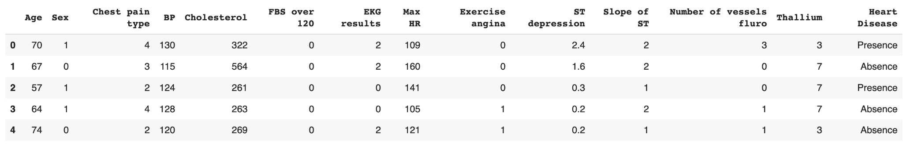
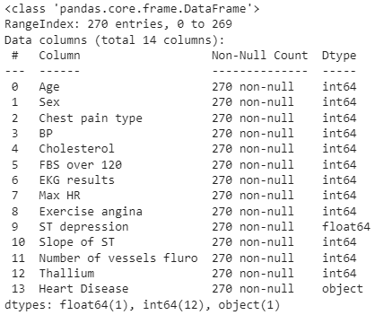
02 Introduction to Dataset
X variables
Y variable

Slide 5
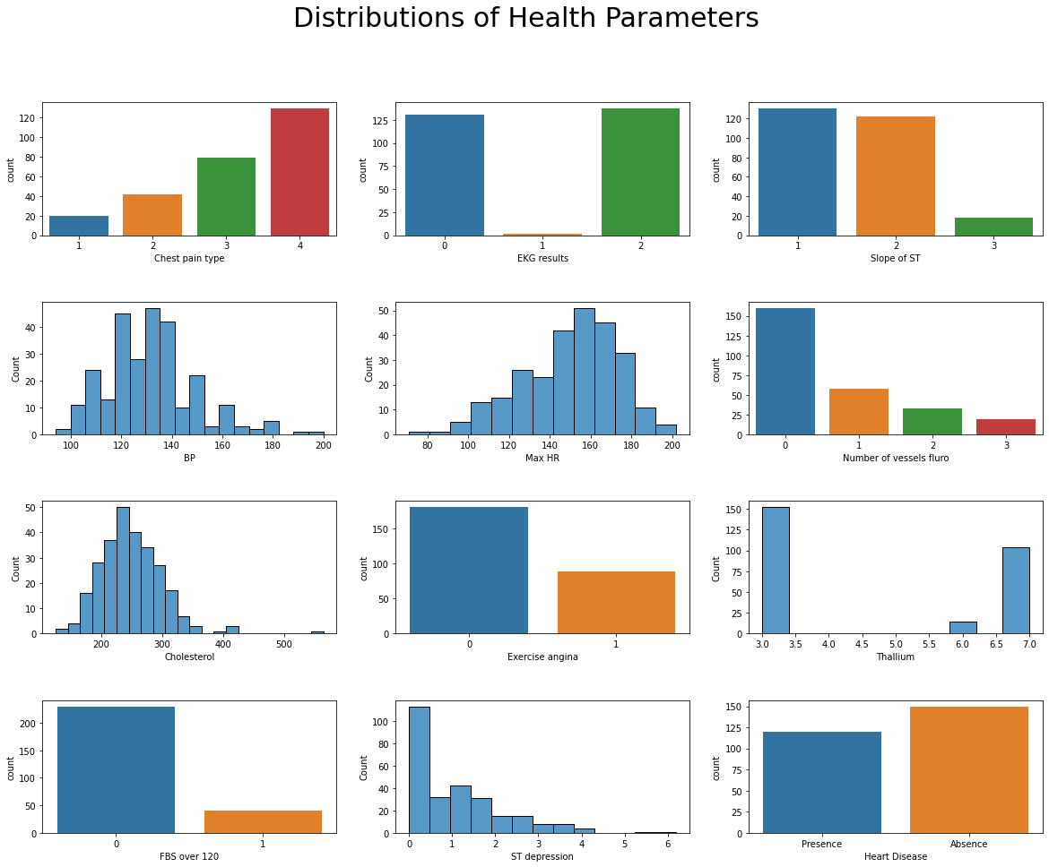
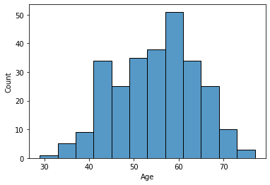
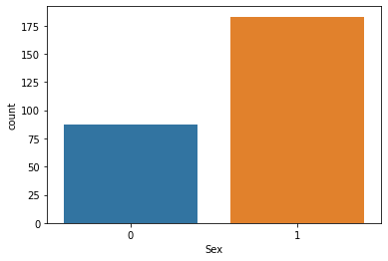
02 Introduction to Dataset – EDA

Slide 6
03: Methodology – Data Pre-processing, Model Selection and Training
Data Pre-processing:
Check for NA values → No NA values
Model Selection and Training
The data was split into training and test set using the train_test_split function (80:20)
Since it is a classification problem, Logistic Regression and Random Forest Classifier were used.

Slide 7
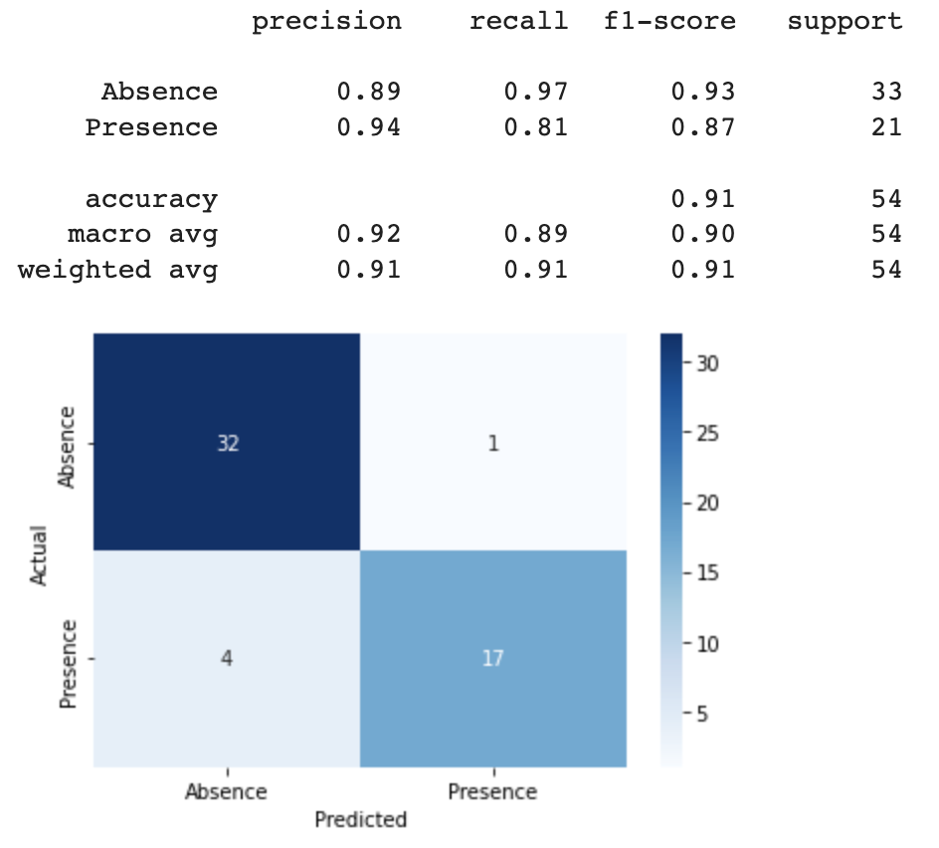
04: Test set results & model interpretation
Using Logistic Regression
High precision, High recall, High f1-score
Model is able to effectively classify patients with Heart Disease and patients without Heart Disease

Slide 8
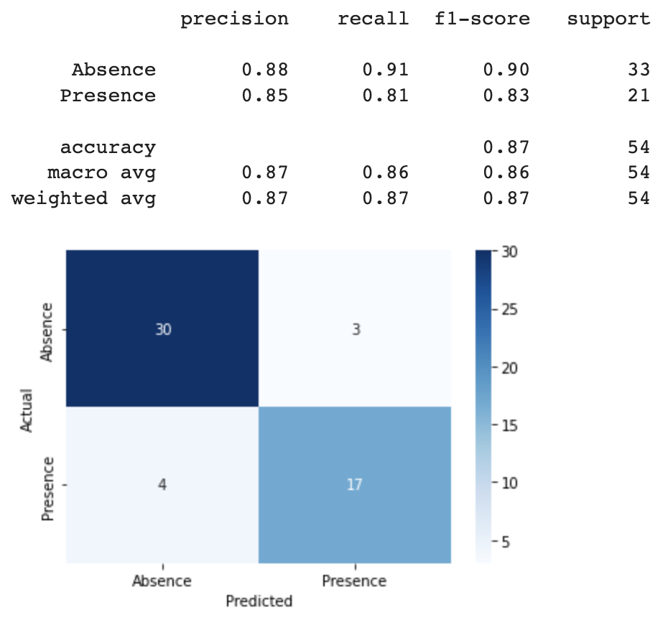
04: Test set results & model interpretation
Using Random Forest Classifier
High precision, High recall, High f1-score
Model is also able to effectively classify patients with Heart Disease and patients without Heart Disease

Slide 9
05: Business Insights
Model Selection
In the context of Heart Disease Prediction, recall is more important than precision.
Precision: What proportion of positive identifications were actually correct?
Recall: What proportion of actual positives were identified correctly?
It is better to identify a person without Heart Disease as one with Heart Disease rather than to identify a person with Heart Disease as one without Heart Disease.
Hence, the ML algorithm to use is Logistic Regression since it has a higher recall.

Slide 10
Thank you!

